Slide 1

Waterfall Model in SDLC

Slide 2
INTRODUCTION
A software development process or life cycle is a structure imposed on the development of a software product. There are several models for such processes, each describing approaches to a variety of tasks or activities that take place during the process.

Slide 3
Waterfall Model
Waterfall model is a popular model of the system development life cycle.
It is very simple to use and understand.
The waterfall Model illustrates the software development process in a linear sequential flow.
This means that any phase in the development process begins only if the previous phase is complete. In this waterfall model, the phases do not overlap.

Slide 4
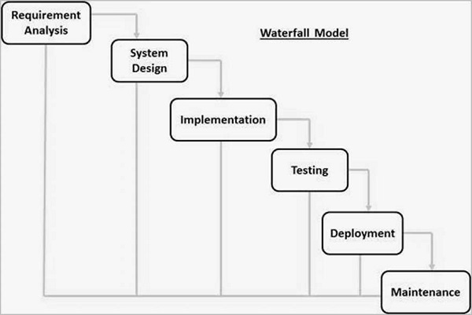

Slide 5
Steps in Waterfall Model
1) Requirements Analysis: Requirements is the initial step in waterfall model.
All possible requirements of the system to be developed are captured in this phase and documented in a requirement specification document.
In this steps user demands the entire requirement for the software development.

Slide 6
2) System Design: This is the second step in waterfall model.
This system design helps in specifying hardware and system requirements and helps in defining the overall system architecture.
This system design helps in specifying hardware and system requirements and helps in defining the overall system architecture.

Slide 7
3) Implementation: It is very important part of waterfall model.
After requirements and design the next step in implementation.
With inputs from the system design, the system is first developed in small programs called units, which are integrated in the next phase.
Each unit is developed and tested for its functionality, which is referred to as Unit Testing.
The main purpose of these steps is to execute the program.

Slide 8
4) Testing: In these steps the entire systems will be tested for any faults and failures.
Once the functional and non-functional testing is done the product is deployed in the customer environment or released into the market.
Initially developers will perform unit testing and integration testing using of white box testing.
After that separate team will be perform system testing using black box testing

Slide 9
5) Deployment: Once the functional and non-functional testing is done; the product is deployed in the customer environment or released into the market.
This is essentially allowing the customer/client to essentially run the product in their environment.

Slide 10
6) Maintenance - After the testing client satisfied on work product then we deliver application to the customer to use at live environment.
Also to enhance the product some better versions are released.
Maintenance is done to deliver these changes in the customer environment.

Slide 11
Advantages
This model is simple and easy to understand and use.
It is easy to manage due to the rigidity of the model – each phase has specific deliverables and a review process.
In this model phases are processed and completed one at a time. Phases do not overlap.
Waterfall model works well for smaller projects where requirements are very well understood

Slide 12
Disadvantages
Once an application is in the testing stage, it is very difficult to go back and change something that was not well-thought out in the concept stage.
No working software is produced until late during the life cycle.
High amounts of risk and uncertainty.
Not a good model for complex and object-oriented projects.

Slide 13
Poor model for long and ongoing projects.
Not suitable for the projects where requirements are at a moderate to high risk of changing.

Slide 14
Uses of Waterfall Model
This model is used only when the requirements are very well known, clear and fixed. Product definition is stable.
Technology is understood.
There are no ambiguous requirements
Ample resources with required expertise are available freely
The project is short/long depending on the requirement

Slide 15
Thanking You, Q/A Session
Anant
Avinash
Vishal
Shreyash

